Slide 1


Details
Name Vedant Nehal
College Name Christ University Lavasa
Problem Statement Automatic Video Tagging and Localization

Slide 2

Brief About the Idea: Automatic Video Tagging and Localization The idea revolves around developing a tool that enhances the discoverability and accessibility of videos across different languages and regions. The solution automatically analyzes video content to generate relevant tags based on objects, scenes, and text detected within the video. These tags are then translated into multiple languages, making the video content more accessible to a global audience. Key Aspects: Automation: The tool uses machine learning algorithms to automatically detect and tag elements within a video, removing the need for manual tagging. Multilingual Translation: It supports the translation of tags into various languages, ensuring that videos can reach non-English speaking audiences without additional effort. Improved Discoverability: By generating and translating tags, the tool enhances the video’s visibility on search engines and video platforms, catering to a broader, global audience.

Slide 3
1. How Different is it from Other Existing Ideas?
Unique Feature Set: Explain how your solution offers a combination of features not found together in other tools. For example, if your project involves automatic video tagging and multilingual localization, highlight how the seamless integration of these features in one tool sets it apart.
Customization and Scalability: If your tool is customizable to specific industry needs or scalable to handle large datasets efficiently, emphasize this point.
Accuracy and Speed: Mention any optimizations in algorithms or the use of advanced models that improve the accuracy and speed of video analysis and tagging.
.
2. How Will it Solve the Problem?
Enhanced Discoverability: Your solution automatically generates relevant tags based on video content, making videos more discoverable in search engines and platforms.
Global Accessibility: By translating tags into multiple languages, it allows content creators to reach a broader, global audience without additional effort.
Efficiency: Reduces manual effort and time required for video tagging and localization, enabling content creators to focus on creating more content.
3. USP of the Proposed Solution
Automation: The automation of both tagging and multilingual localization in one workflow is a key selling point.
Integration: Ability to seamlessly integrate with existing video platforms or content management systems, reducing the friction of adoption.

Slide 4
.
List of features offered by the solution
1. Video Content Analysis
Object Detection: Automatically identifies and categorizes objects present in video frames using machine learning models.
Scene Recognition: Detects and categorizes different scenes in the video to generate more specific and context-aware tags.
Text Detection: Recognizes on-screen text, which can be used as tags or translated into multiple languages.
2. Automated Tag Generation
Keyword Extraction: Generates tags based on the content detected in the video, such as objects, scenes, and text.
Contextual Tagging: Generates tags that reflect the context or theme of the video, improving relevance and discoverability.
Dynamic Tag Updates: Updates tags dynamically as new content is detected throughout the video.
3. Multilingual Translation of Tags
Multiple Language Support: Translates generated tags into several languages like English, Hindi, Marathi, etc., using translation APIs.
Accurate Contextual Translation: Ensures that translations are contextually accurate, preserving the meaning and relevance of the original tags.
Custom Language Selection: Allows users to choose which languages they want the tags to be translated into.
4. Real-Time Processing
Instant Tagging: Tags are generated in real-time as the video is being processed.
On-the-Fly Translation: Tags are translated immediately after being generated, ensuring that all processes happen without delay.
5. User Interface and Integration
Simple Video Upload Interface: Easy-to-use interface for users to upload videos and start the tagging and translation process.
API Access: Provides an API that can be integrated into existing video platforms for seamless tagging and translation.
Batch Processing: Supports the ability to process multiple videos at once, saving time for users dealing with large volumes of content.
6. Customization and Flexibility
Custom Tagging Rules: Users can define specific rules or guidelines for tag generation based on their preferences or industry standards.
Language Preferences: Users can customize which languages to translate tags into, tailoring the solution to specific regional needs.
Editable Tags: After generation, users have the option to review and edit tags before finalizing them.
7Compliance with Privacy Laws: Designed to comply with global privacy laws, ensuring user data is protected and used ethically.

Slide 5
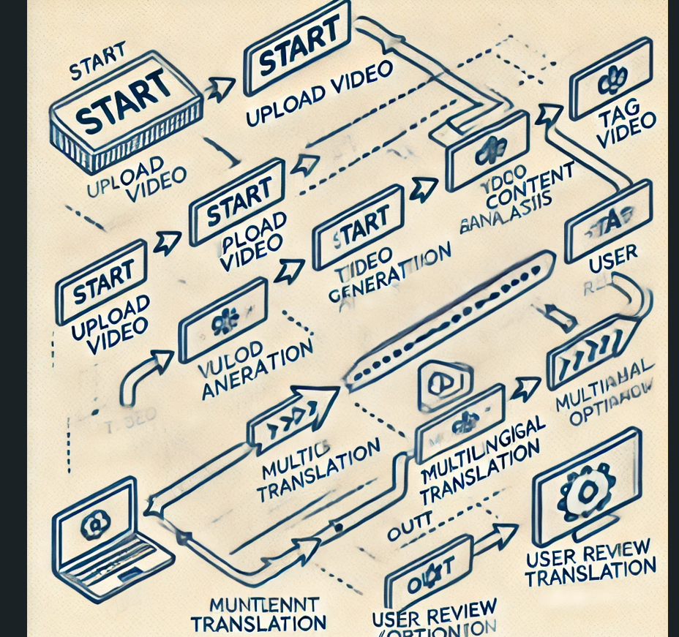
Here is the process flow diagram for your Automatic Video Tagging and Localization system. It visually represents the sequence of steps from starting the process to the final output.
Process flow diagram or Use-case diagram

Slide 6
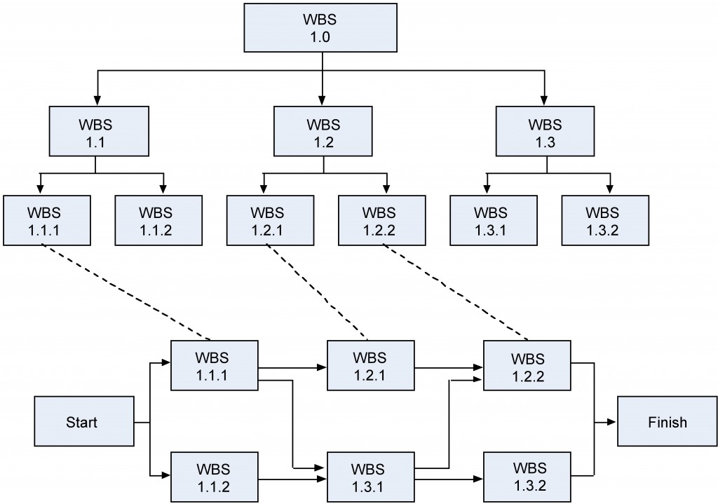
Wireframes/Mock diagrams of the proposed solution (optional)

Slide 7
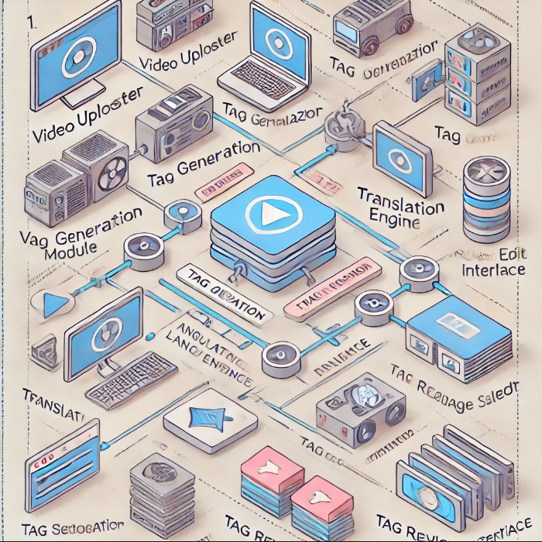
Architecture diagram of the proposed solution

Slide 8
For the solution of automatic video tagging and localization, you will be using the following technologies: Python: The primary programming language to implement the solution. OpenCV: For video content analysis, including frame extraction and object detection. SpaCy or NLTK: For natural language processing tasks such as tag generation, enhancement, and text analysis. Google Translate API: To translate the generated tags into multiple languages. PyTorch or TensorFlow: Optional, if you need to perform more advanced tasks like deep learning-based object detection. Flask or Django: If you plan to develop a web interface for the tool. These tools will enable you to analyze video content, generate relevant tags, and translate them into various languages to enhance the global discoverability of videos.
Technologies to be used in the solution

Slide 9
1. Development Costs: Software Developers: If you're hiring developers, the cost will depend on their experience and the project's complexity. Time: Estimate how long the development will take and multiply it by the developers' hourly rates. 2. Infrastructure Costs: Cloud Services: Hosting, storage, and computational resources if you're using cloud services like AWS, Google Cloud, or Azure. APIs: Costs associated with using the Google Translate API or other third-party services. 3. Software Licenses: Tools and Libraries: While Python and most libraries are open-source, some specialized tools or enterprise-level APIs might require licenses. 4. Testing and Maintenance: Quality Assurance: Costs related to testing, debugging, and ensuring the system is stable. Ongoing Maintenance: After deployment, there may be costs for updates, fixing bugs, and adding new features. 5. Miscellaneous Costs: Training: Costs for training staff or users on how to use the new tool. Marketing and Deployment: If you plan to commercialize the tool, consider marketing and deployment costs.
Estimated implementation cost (optional)

Slide 10
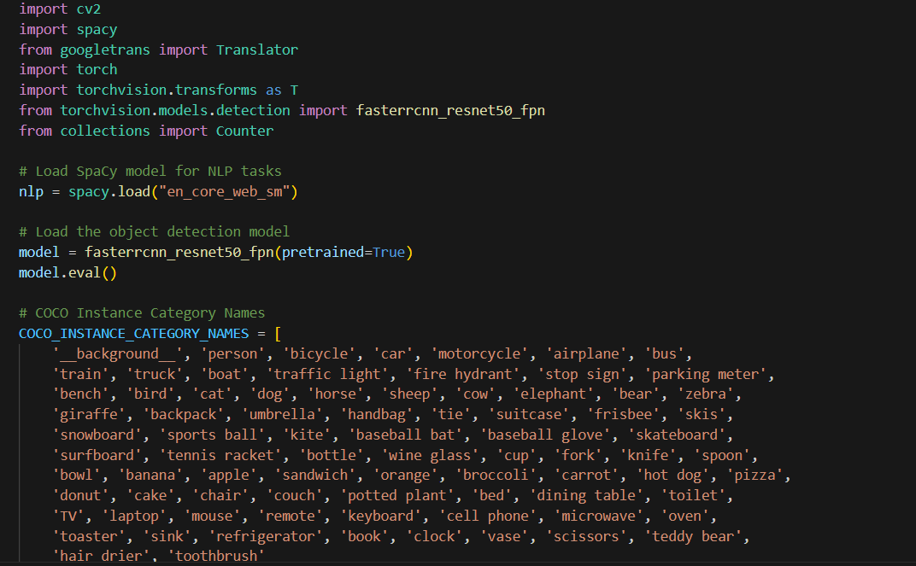
Snapshots of the prototype

Slide 11
Future Development Integration with Video Platforms: Implement seamless integration with popular video platforms like YouTube, Vimeo, or social media sites to automate tagging and localization directly from these platforms. Real-Time Video Analysis: Develop a real-time version of the tool that can analyze and tag live video streams, which could be valuable for live broadcasts or security footage. Advanced AI Models: Incorporate more advanced AI models for video content analysis, such as those that can detect emotions, actions, and complex scenes. Customizable Tagging and Translation: Allow users to customize the tagging and translation process, including setting preferences for specific languages, dialects, or industry-specific terms. User Feedback Loop: Introduce a feedback mechanism where users can approve, reject, or refine the generated tags and translations, improving the model over time. Multimodal Analysis: Extend the analysis to include audio content in the videos, generating tags based on speech recognition and sound identification.
Additional Details/Future Development

Slide 12
Thank You!!

